Slide 1
Unemployment in India
Mennatallah EL-Khateeb
The story behind this dataset is how lockdown affects employment opportunities and how the unemployment rate increased during Covid-19.

Slide 2
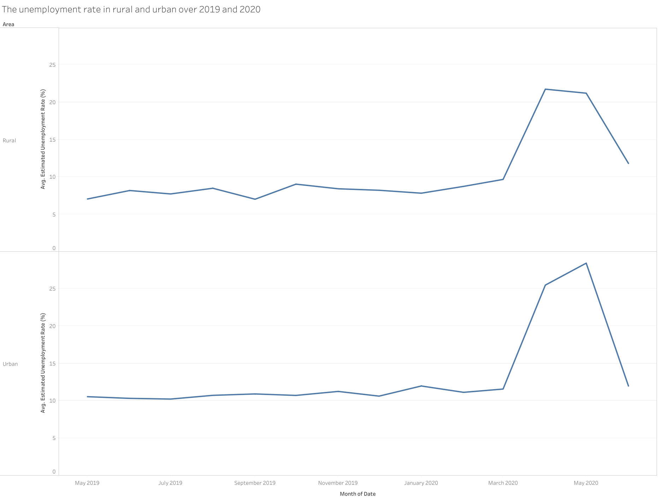
Covid-19 impact on urban and rural unemployment
We note that the unemployment rate has risen significantly since the beginning of the pandemic.

Slide 3
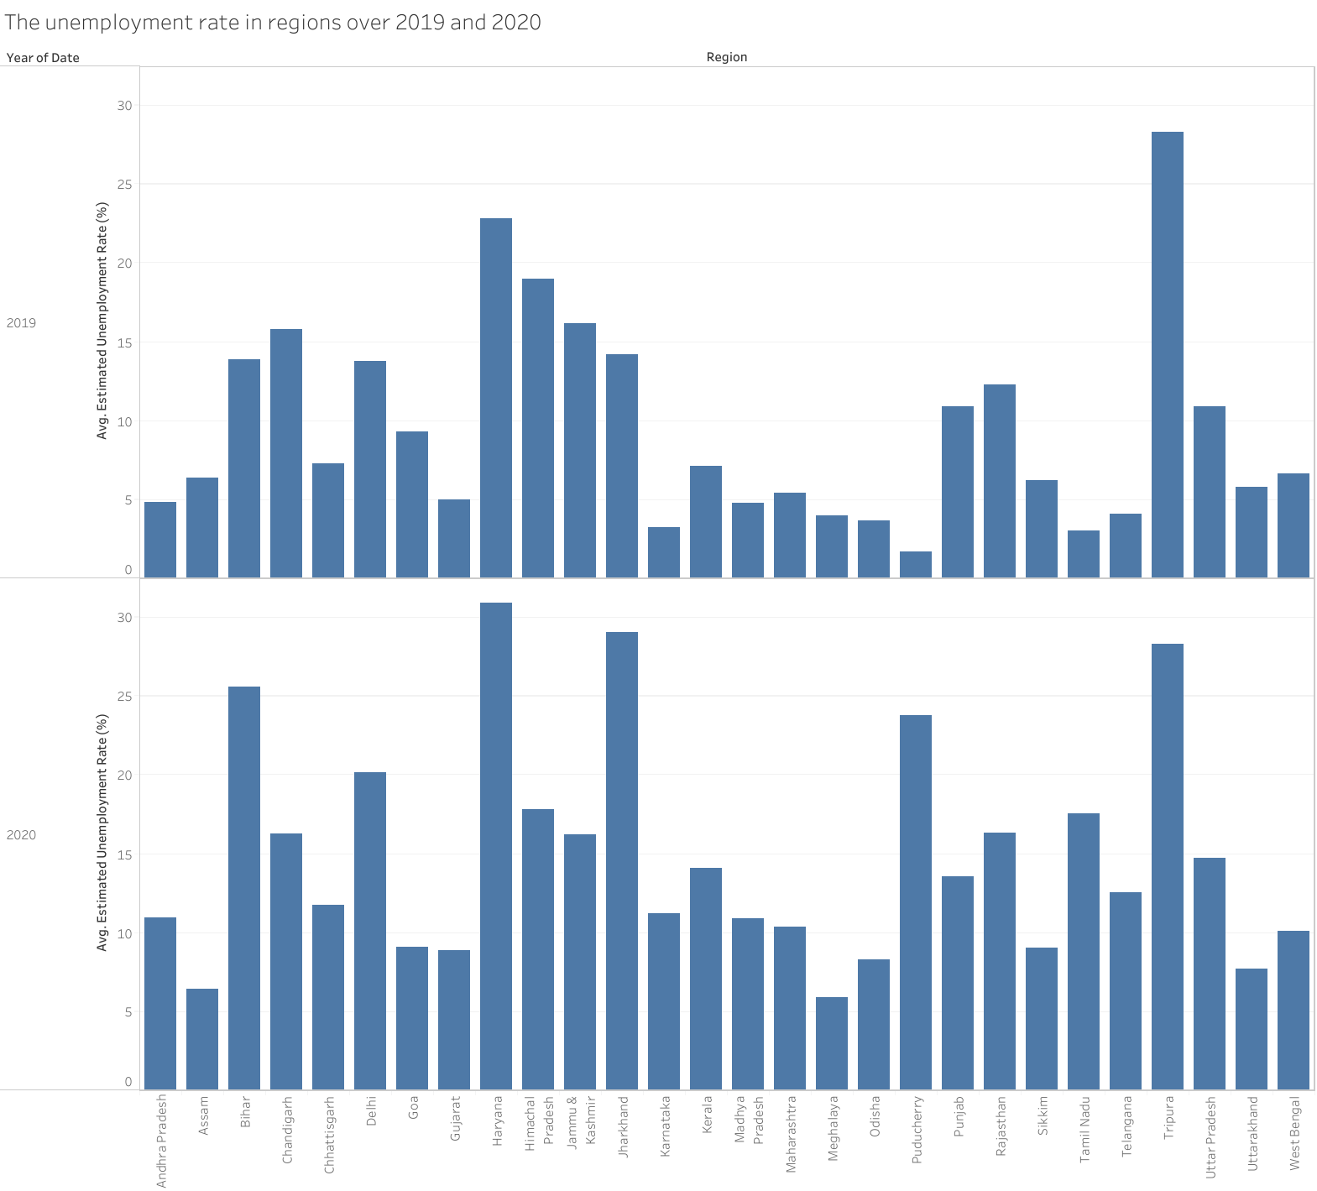
Impact of the pandemic on the unemployment rate in different cities within India 2019-2020
We note the high tax rate in the city of Tripura during and before the pandemic
As the pandemic spreads, the unemployment rate has increased in several cities, including Haryana.

Slide 4
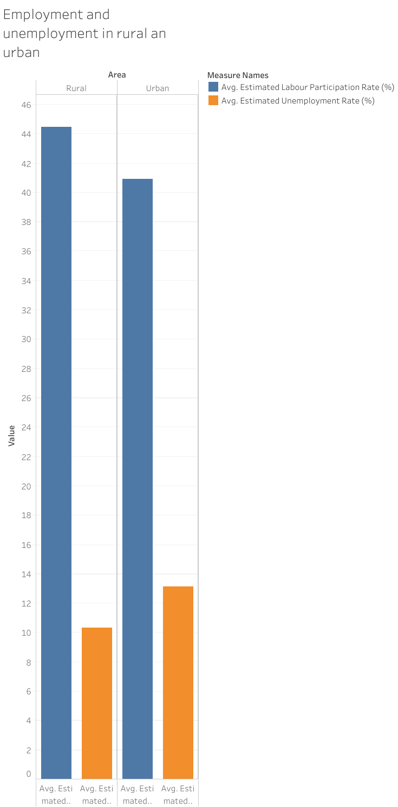
Urban and Rural Unemployment and Employment Rates 2019-2020
We note higher rural than urban employment rates with higher urban unemployment compared to rural

Slide 5
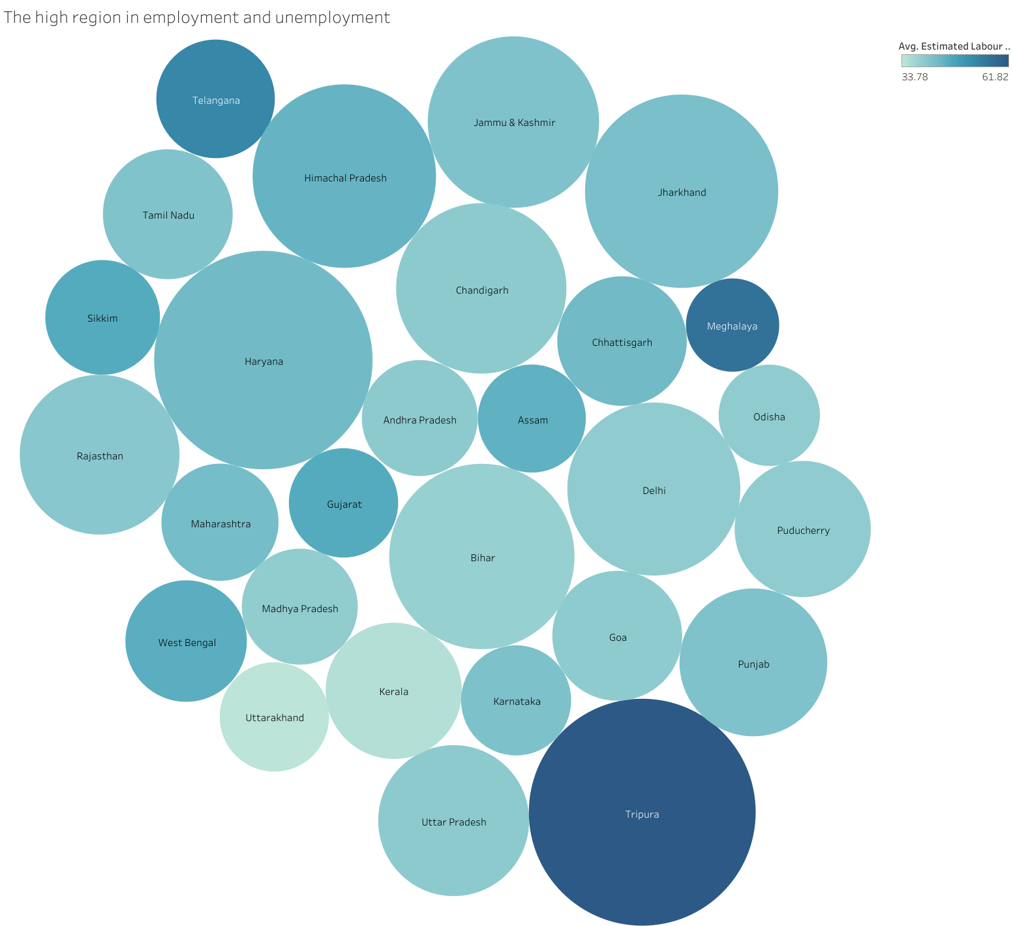
Concentration of employment and unemployment in regions
We note the high employment in Tripura City with high unemployment in Haryana and low employment compared to others

Slide 6
